Slide 1

Girl Develop It!
User Experience Job Prep
07/14/2021

Slide 2
Welcome!

Slide 3
What brings you here?
Take a moment to think about what brought you here today.
As a UX practitioner, what challenges are you experiencing that spiked your interest in joining GDI’s UX Job Prep course? Place these thoughts into the chat!

Slide 4
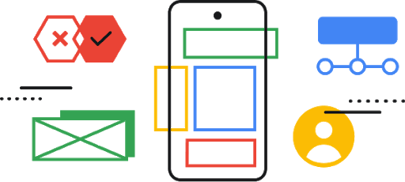
Who is this class for?

Slide 5
Who is this class for?
The recent bootcamp graduate

Slide 6
Who is this class for?
The recent bootcamp graduate
The individual who took one or a few UX courses online

Slide 7
Who is this class for?
The recent bootcamp graduate
The individual who took one or a few UX courses online
The individual with a relevant background in design

Slide 8
Who is this class for?
The recent bootcamp graduate
The individual who took one or a few UX courses online
The individual with a relevant background in design
Anyone ready to make a move to the field of UX

Slide 9
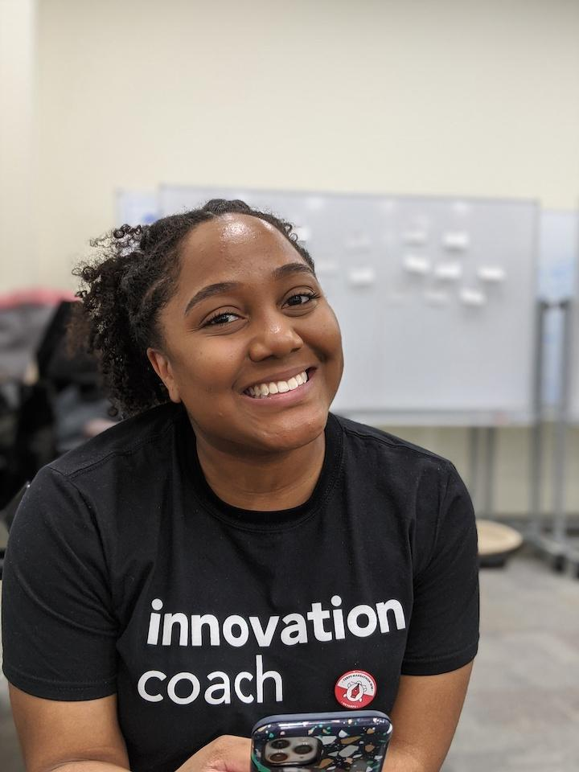
MEET YOUR INSTRUCTOR
LaRia Rogers (She/Her)
Designer, Researcher and Educator based in Maryland

Slide 10
Three steps in prepping for a career in UX

Slide 11
Step 1: Get out of your own way.

Slide 12
Does this remind you...of you?
My case studies are perfect, no edits needed.
My resume is perfect, no edits needed.
I don’t need to talk to Senior Designers, they don’t understand nor relate to me.
I apply to 50 jobs a day. I’m putting in the effort.

Slide 14
Be humble! Follow these steps (trust me):
Reach out and schedule time with your peers, HR professionals and non-designers - Do I look like a design professional?

Slide 15
Be humble! Follow these steps (trust me):
Reword. Rephrase. Reiterate.
Reword your experience as it relates to UX
Rephrase your responsibilities as success towards to company, team and mission
Reiterate your value as it relates to the job in which you’re applying for by placing keywords pulled from the job description

Slide 16
Be humble! Follow these steps (trust me):
Strategically apply to roles based on your interest within UX
Company (product, service, mission, etc.)
Location
Salary + benefits (levels.fyi and glassdoor)
Internal growth (LinkedIn)

Slide 17
Step 2: Network with UX Professionals (the right way).

Slide 18
How to network (the right way):
Discovery what roles interest you and why
Do you like working with products?
Do you like working with physical artifacts?
Do you like working with android and iOS?

Slide 19
How to network (the right way):
Draft three bios
Short version in third person “LaRia is a designer...”
Long version in third person “LaRia is a designer with a background in project management…”
Short version in first person “I am a designer…”

Slide 20
How to network (the right way):
Look at your personal network
Use a personal bio + 1-2 reasons why you want to work for X company

Slide 21
How to network (the right way):
Join a community (a check it often for updates)
Conferences, slack channels, discord channels and Twitter

Slide 22
Step 3: Prep for a design interview.

Slide 23
A portfolio ≠
a portfolio presentation

Slide 24
A portfolio presentation
A “sales tool” for potential employers and teams:
About you
Career overview
1-2 case studies
Thank you + contact

Slide 25
A portfolio presentation
About you
Use your short bio here!
1-2 interesting/fun facts
Semi-professional image

Slide 26
A portfolio presentation
Case Studies
Overview/background
The problem
The goal(s)
The team (and your role)
Your design process (short and sweet)
Solution
Learnings

Slide 27
A portfolio presentation
Thank you + contact
Email
Social
Portfolio URL

Slide 28
Step 4: ?? TBD
What will you do next?

Slide 29
Thank You!
We appreciate your feedback! Please complete the short survey (in zoom link).
Let’s keep in touch!
rogerslaria@gmail.com

